Slide 1
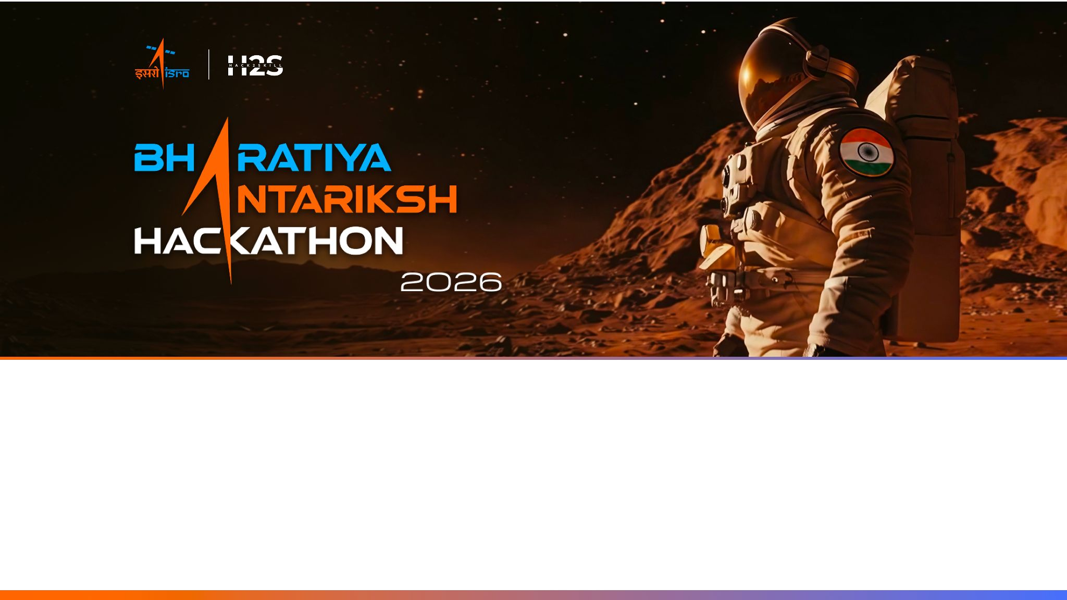
T e a m N a m e : C l i m a t e B h a r a t
T e a m L e a d e r : A n k u s h H o n n a l l i
P r o b l e m S t a t e m e n t : A I - P o w e r e d D i g i t a l T w i n o f I n d i a ‘s C l i m a t e u s i n g
I n d i a’s N a t i o n a l D a t a

Slide 2
Team Members
Team Leader: Name:Ankush Honnalli College:SUK | Team Member :2 Name:Niranjan College:SUK
Team Member:1 Name:Pruthviraj College: Sanjay Ghodawat University | Team Member:3 Name: Shubham College:Gogte intsitute of technology

Slide 3
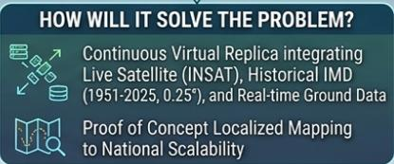
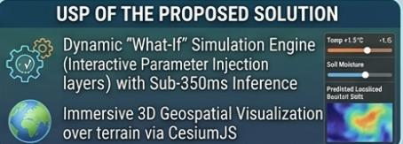
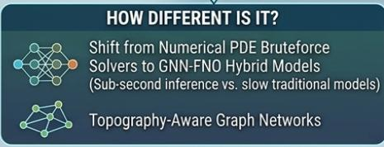
Opportunity Analysis of What Makes Us Different:
1. Al-Driven vs. Slow Math Solvers Our Way: A high-velocity, data-driven Al framework built specifically for the Indian subcontinent's unique weather dynamics.
2. Live National Data Integration Our Way: A continuous virtual replica blending live INSAT satellite feeds, ground instruments, and 70+ years of IMD history.
3. Interactive "What-If" Simulation Engine Our Way: An active testing engine- change variables (like adding 1°C) to see instant, localized impacts on rainfall and greenhouse gases.
4. Immersive 3D Visualizations Our Way: Scannable, multi-dimensional 3D dashboards (via CesiumJS and Streamlit) for district-level tracking at a single glance.

Slide 4
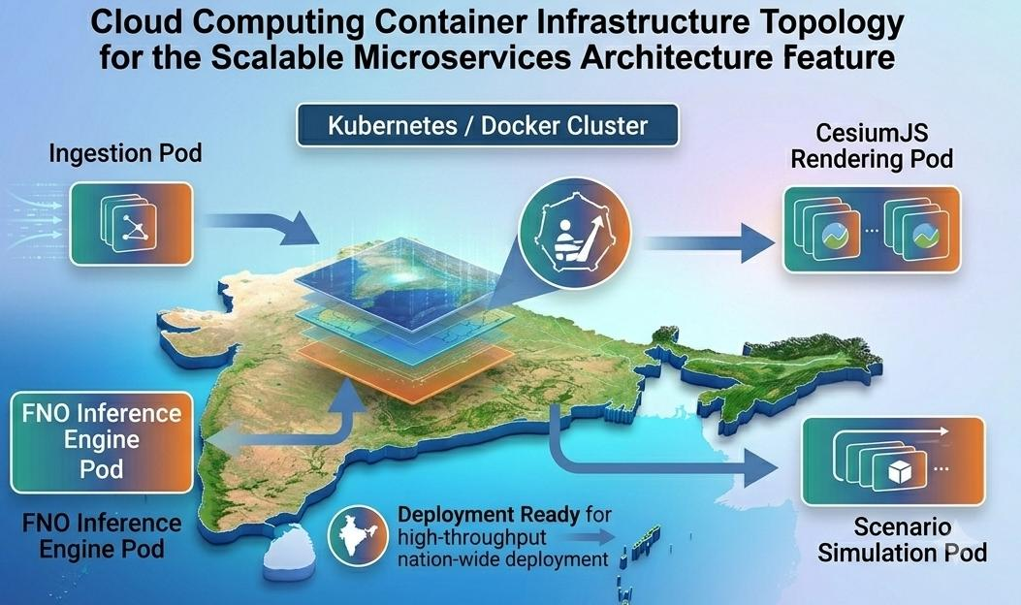
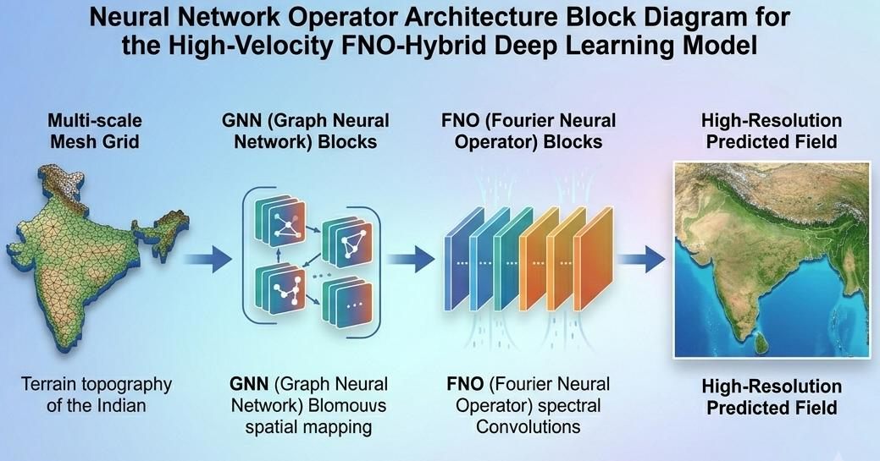
List of features offered by the solution
Project: Al-Powered Climate Digital Twin for India
1.Continuous Virtual Replica & Live National Data Integration blending Satellite and Ground station observations.
2.High-Velocity FNO-Hybrid Deep Learning Model:for sub-second prediction and inference.
3.Dynamic 'What-If' Simulation Engine:district-level tracking over terrain via CesiumJS
4.Physics-Informed Neural Network (PINN) Loss Constraints: ensuring realistic outputs and targetis >85% prediction accuracy
5.Scalable Microservices Architecture:for national deployment scenarios.

Slide 5
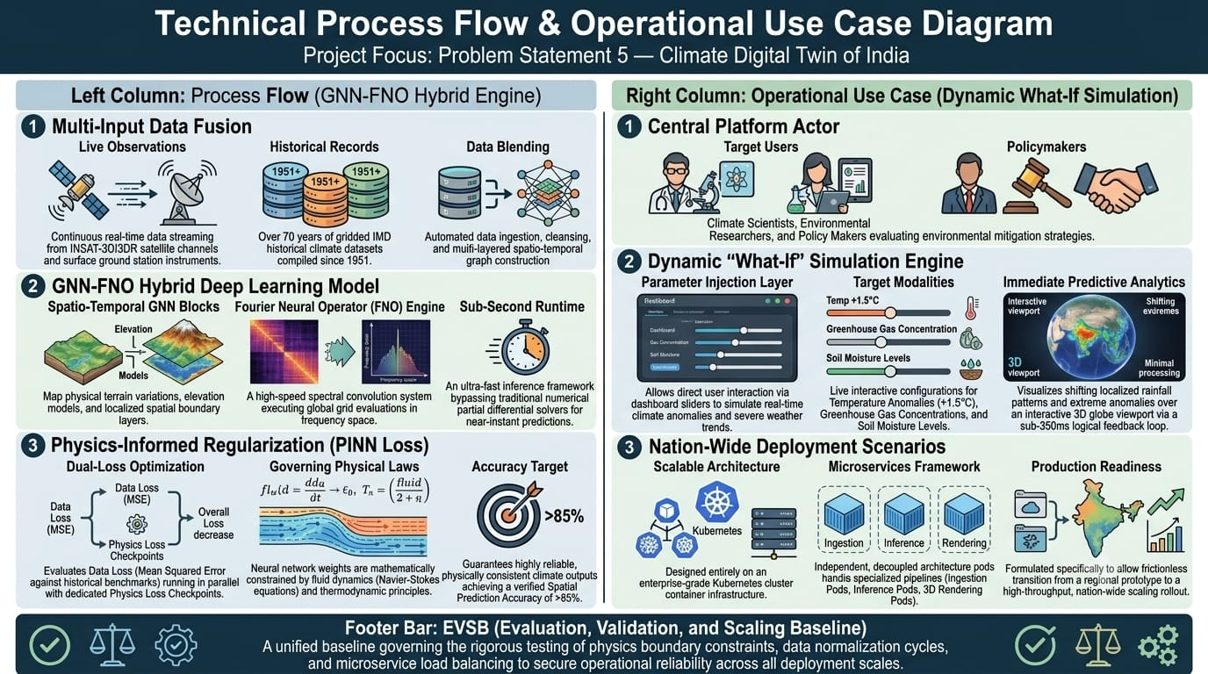

Slide 6
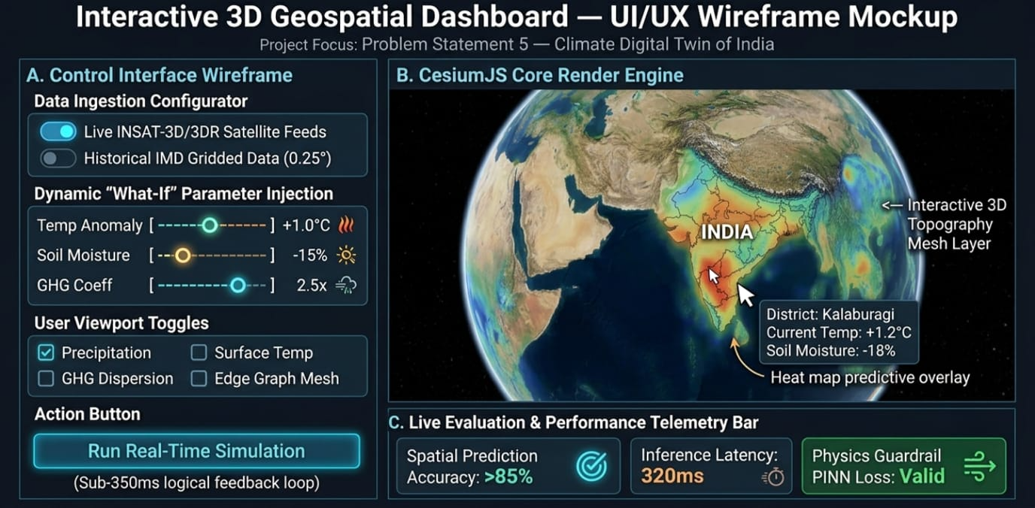

Slide 7
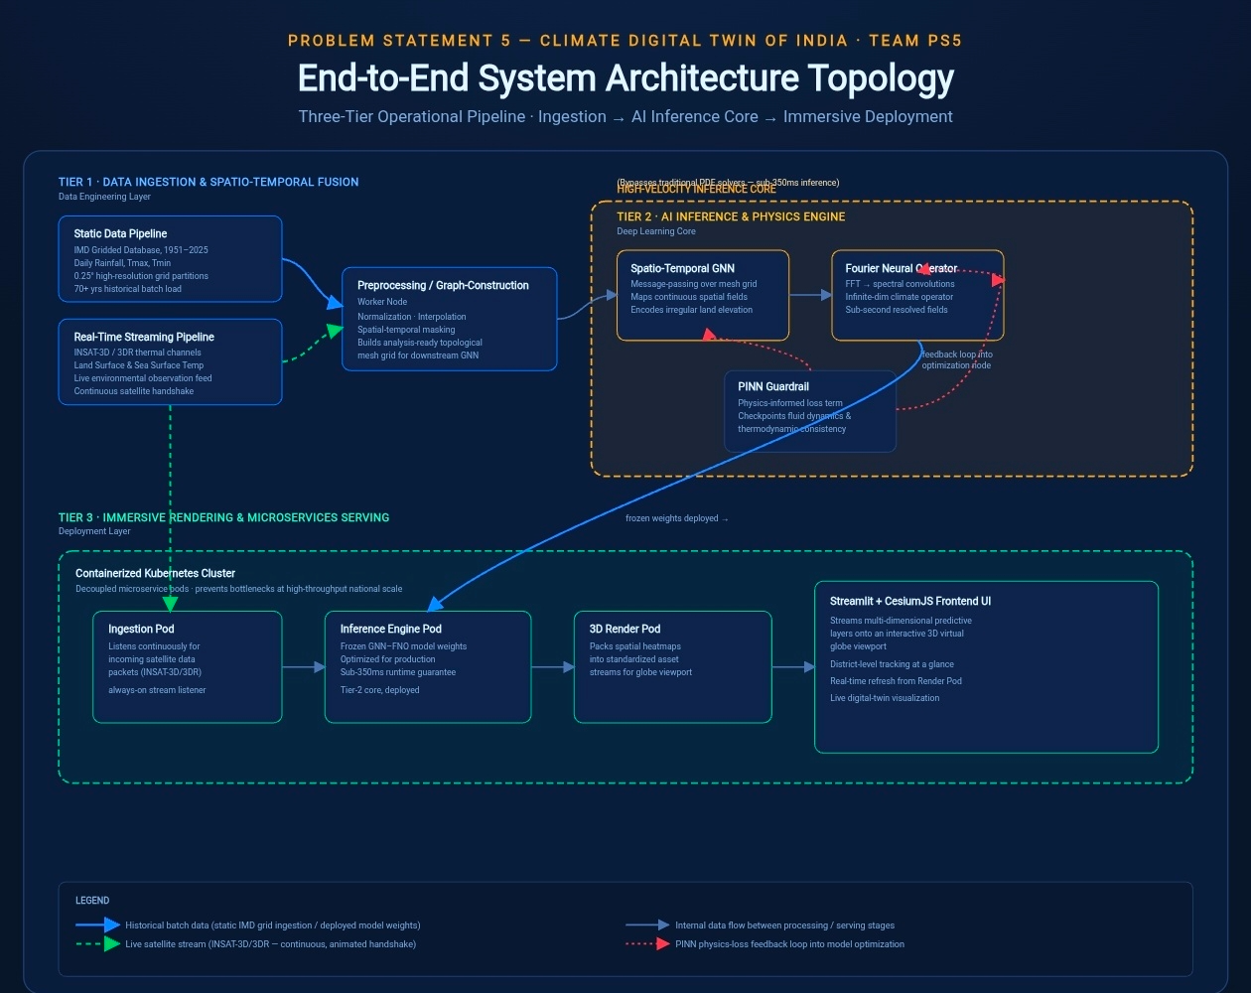

Slide 8
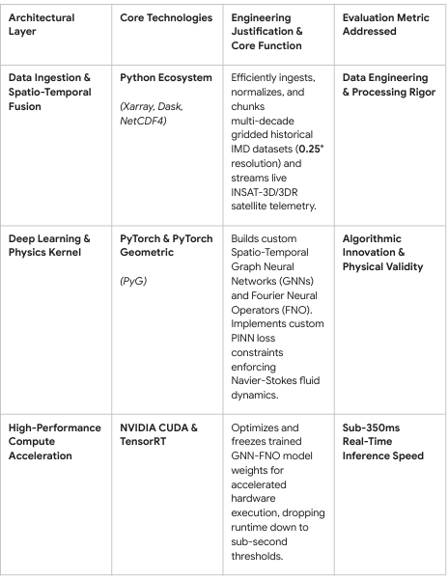
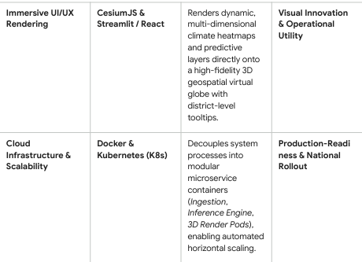
Technologies to be used in the solution:

Slide 9
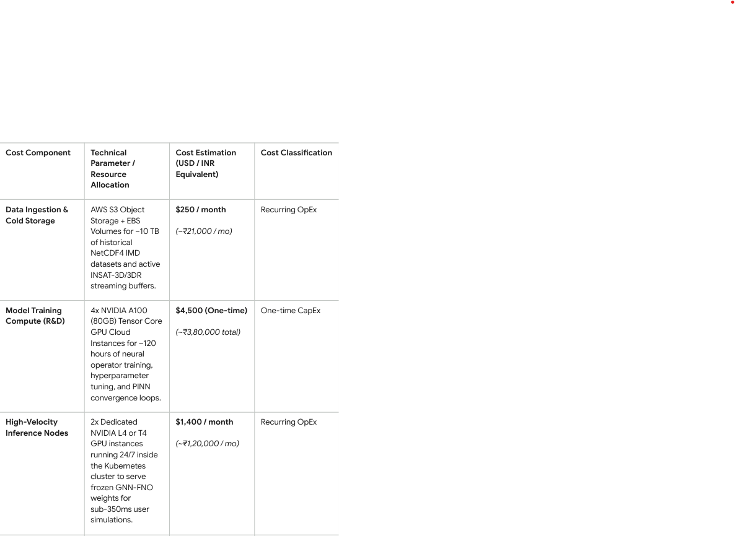
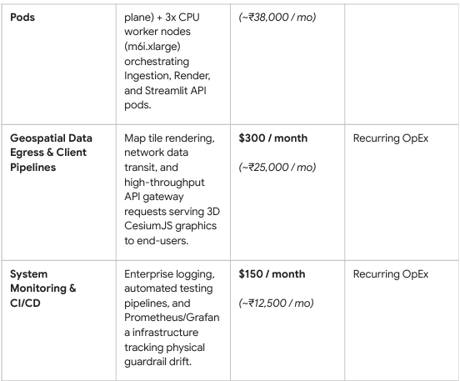
Estimated implementation cost (optional):

Slide 10


